Slide 1
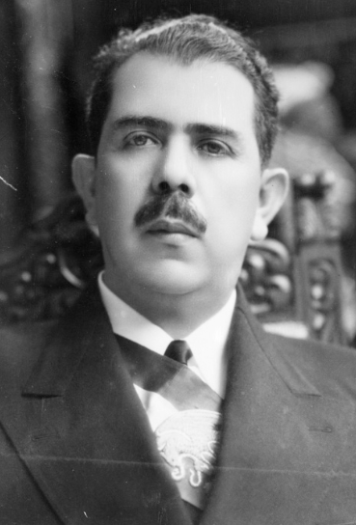
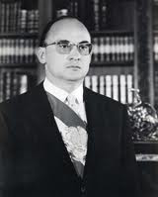
Nunca antes un modelo Constitucional tan restrictivo…
L. CÁRDENAS
A. LÓPEZ MATEOS
L. ECHEVERRÍA
Notes:
Although Mexico does not have a petrolized economy (the share of hydrocarbons to total GDP is only 8.1% and exports of oil and gas account for 14% of total), its public finances are petrolized , as the petroleum industry contributes with more than a third of government’s income.

Slide 2
Fortalecer a CFE sin perderla en la política…
Artículo 25 Constitucional:
Se eliminan:
Controles corporativos
Financieros
Operativos
Transparencia e institucionales
Obligación legal de generar valor económico
Transitorio Segundo:
Comisión de Administración y Supervisión de los Activos del Estado
Valor Económico = valer MÁS costar MENOS
Corporación de la Red Estatal China
Notes:
Although Mexico does not have a petrolized economy (the share of hydrocarbons to total GDP is only 8.1% and exports of oil and gas account for 14% of total), its public finances are petrolized , as the petroleum industry contributes with more than a third of government’s income.

Slide 3
Concentración de los pesos y contrapesos en CFE…¿Beneficia a los usuarios?
CANCELADO
PLANEACIÓN
REGULACIÓN
CANCELADO
CANCELADO
CONTROL
TARIFAS
CANCELADO
Autonomía Constitucional
Art. 134
Constitucional
Toda la cadena de valor
CANCELADO
Eficiencia,
Economía, Transparencia Honradez
CANCELADO
180 días para TODA LA REFORMA FEDERAL
Notes:
Although Mexico does not have a petrolized economy (the share of hydrocarbons to total GDP is only 8.1% and exports of oil and gas account for 14% of total), its public finances are petrolized , as the petroleum industry contributes with more than a third of government’s income.

Slide 4
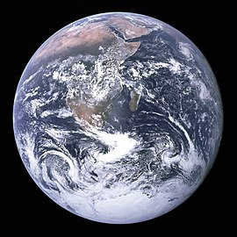
¿Con qué recursos crecer y lograr la transición energética?
Inversión anual 4.3 Trillones USD (X4)
Adiciones anuales 1 millón MW (X4)
58 millones de autosE anuales (X18)
30 millones de empleos
PRODESEN
PEF 2022
$101 MIL MILLONES USD
$1.7 MIL MILLONES USD
LO QUE SE NECESITA HACIA 2032…
LO QUE HAY…
Notes:
Although Mexico does not have a petrolized economy (the share of hydrocarbons to total GDP is only 8.1% and exports of oil and gas account for 14% of total), its public finances are petrolized , as the petroleum industry contributes with more than a third of government’s income.

